Slide 1
Cumbria
Connect to Work
Pre-Market Event
18 July 2025

Slide 2
Housekeeping
These slides will be published on our website within 24-hours of this event
Please hold any questions back until we get to the Question-and-Answer session.
If we don’t get to all your questions today, email them in or hand them to one of the team on a piece of paper.
We aim to answer and publish the Question-and-Answer log with 72-hours of this event, but some questions could take a little longer to answer so this could be iterative
This market engagement event is from 10am until 12.30. This room will be available after that, until 3pm, if you want to use it – this is not part of are market engagement / procurement activity
Notes:
Isobel

Slide 3
Agenda
Today, we plan to cover:
  Background
  Cumbria Connect to Work
  Proposed procurement approach
  Commercial expectations
  Market feedback session
  Next steps and closing remarks
Notes:
Isobel

Slide 4
Introductions
Introduce key team members:
Isobel Brown, Programme Director – Enterprising Cumbria
Hani Milburn-Cox, Programme Manager – Cumberland Council
Caroline Powney, Strategic Advisor – Westmorland and Furness Council
Garry Chambers, Consultant
Kevin Higgins – Supported Employment Implementation Specialist, DWP
Notes:
Isobel

Slide 5
Background
Notes:
Hani

Slide 6
Connect to Work [CtW]
Programme Overview:
  CtW will support up to 100,000 disabled people, people with health conditions and those with complex barriers to employment to get into work per year nationally.
  Primarily focusing on those who are inactive but will also support some people who are at high risk of becoming inactive if they fall out of work or are unemployed.
  Long-term sickness continues to be the most common reason for non-engagement in the Labour Market amongst the working age population.
1
Notes:
Hani
Universal Support is a key plank in the Back to Work Plan. It will help the high numbers of disabled citizens and those with health conditions who are outside the labour market and who wish to be in employment, and those with more complex barriers to work, to find a suitable job and sustain work.
IPS integrates employment support alongside primary and secondary health services, and other support services. This integration ideally occurs at a physical level, through co-location and other policies, where applicable. IPS has been successfully utilised by DWP within the Individual Placement and Support in Primary Care (IPSPC) programme to support individuals with low to moderate health and/or physical health conditions.
SEQF is (as required) a more intensive intervention than IPS, due to the depth of support. In delivery terms, this may mean that a participant will receive more contact and support from their Employment Specialist. The SEQF fidelity scale covers the five phases of the participant journey plus Business Results. The SEQF model typically supports individuals with learning disabilities, autism and/or other complex disadvantages. The SEQF model does not involve integration of Employment Specialists into clinical teams. SEQF has been successfully utilised by DWP within the Local Supported Employment (LSE) programme.
Universal Support will be open to people in those groups at risk of losing paid work and those who have been seeking work and unable to secure stable employment.

Slide 7
Hidden Unemployment
CtW will take a collaborative, locally led approach to tackling ‘Hidden Unemployment’.
It will connect local work, health and skills support, building a coherent, systematic and joined-up approach to maximise the benefits available for individuals and local communities.
It reinforces council priorities at both councils for increasing economic growth through supporting our residents and employers.
It marks an important first step towards the future devolution of employment support, with both councils on the Devolution Priority Programme.
Work
Skills
Health
Supported Employment
Notes:
Hani

Slide 8
Summary of the 12 principles
Supported Employment: 12 Principles
There are twelve core values of Supported Employment
Understand the positive contribution in the workplace.
Real jobs
Zero rejection
Work readiness not a helpful concept
Job search should happen at the earliest opportunity.
Choice and Control
Partnership
Full Inclusion
Employer as a customer of supported employment in their own right
Draws on Social Role Valorisation (SRV)
Draws on the social model of disability
Career development
Notes:
Kevin
Supported employment program will be delivered by 49 delivery areas across England and Wales, which are based either on devolution deals that already exist or will exist in the future and will be led by an ‘Accountable Body’ (Local Authority). In Scotland and Northern Ireland, devolution agreements mean they develop and run their own employment provision programmes. DWP’s approach builds on evidence that delivery areas need to meet appropriate economies of scale to deliver effective supported employment offers.
Accountable Bodies may decide whether Supported employment program is delivered in house, via contracted provision, or a mixture of the two. Accountable Bodies will work in partnership with DWP and will be responsible for (list not exhaustive):
Clearly setting out their Delivery Plan and detailing how the area will identify, check and secure eligible and suitable participants.
Leading the implementation of their Supported employment program Delivery Plan, working with all upper tier and unitary Local Authorities within their area, their Health Boards/ICS partners as well as other key local stakeholders.
The commissioning or establishing of a Supported employment program service using both models of Supported Employment (IPS and SEQF) for eligible and suitable participants.
The day-to-day management of the programme and overall accountability for the funding, and how the grant operates.
Marketing activities to raise awareness of Supported employment program with employers and potential participants, highlighting how it might help individuals find or retain work.
Making DWP aware of any current or emerging operational or financial risks, or issues, and any contingency measures put in place.
Ensuring outcomes for participants are delivered, such as sustained employment, in line with the programme’s key performance indicators.

Slide 9
After extensive engagement with a wide range of stakeholders, recognising the range of need in the target group - it was determined that a dual-model approach would ensure the most appropriate support would be available. Connect to Work will allow Local Authorities to choose between the IPS and SEQF models for each participant.
Although the models have many similarities there are some key differences:
Why Two Supported Employment Models?
Individual Placement and Support (IPS)
IPS integrates employment support into primary and secondary health services, and other support services and aims to embed work as a health outcome within the health system. This integration ideally occurs at a physical level.
Supported Employment Quality Framework (SEQF)
SEQF offers a deeper level of support to both the participant and employer due to the more complex needs of the participant group. In delivery terms, this may mean that a participant will receive more contact and support from their Employment Specialist; particularly in work support for both employer and employee.
Notes:
K

Slide 10
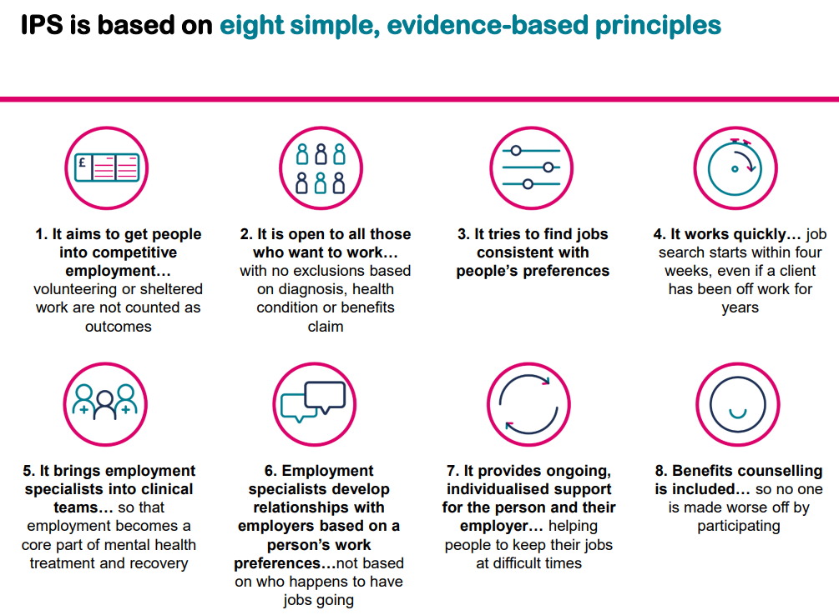
What is IPS (Individual Placement and Support?
Notes:
Kevin

Slide 11
What is the Supported Employment Quality Framework?
The Supported Employment model is a flexible and continuous approach to employment provision. Supported Employment is intensive (with maximum caseloads of 20) and tailored to meet each person’s needs – and those of their employer – through its five stages:
Engagement
An opportunity for a potential participant to learn about Supported Employment and decide whether it is right for them
Vocational profiling
A planning process enabling a participant to identify what they want to achieve and work out a plan for getting there
On and off the job support
The participant is supported to learn the job and sustain employment. This could include job coaching, training/support from a mentor and workplace reviews
Job Matching
The participant is supported to find vacancies that meet the jobseeker’s employment goals
Employer Engagement
The participant learns about the job and works out a plan with the employer on how they will be supported through the recruitment process and in the workplace
Notes:
Kevin
Supported employment program will use the Supported Employment model, an approach that has been used to support disabled people and others who need extra support to move towards and into work. It is based on a philosophy that as long as sufficient support is provided, anyone can work in paid employment if they want to.
The Supported Employment model is a voluntary, flexible and continuous approach to employment support. It is tailored to meet each participant's needs – and those of their employer – through five stages of ‘place train and maintain’:
Placing people into work at the earliest opportunity, Training them to do the work in the way the employer needs it, and providing ongoing support to Maintain them in the job.
Whilst there are slight variations of the definition across the world, there remain three consistent elements that are fundamental to the Supported Employment model:
Paid Work - Individuals should receive commensurate pay for work carried out – if a country operates a national minimum wage, then the individual must be paid at least this rate or the going rate for the job .
Open Labour Market – People with disabilities should be regular employees with the same wages, terms and conditions as other employees who are employed in businesses/ organisations within the public, private or voluntary sectors.
Ongoing Support - This refers to job support in its widest context whilst in paid employment. Support is individualised and is on a need basis for both the employee and the employer.

Slide 12
Differences between IPS and SEQF
IPS
Caseload size is a maximum of 25 for CTW (Fidelity scales is usually 20)
Vocational Profiling is usually complete within the first 2-3 meetings.
Integration with clinical (or other) teams is key to ensure holistic support (evidence shows this can help recovery).
In-work support needs will vary depending on the individual employer and employee but will typically be less intense than SEQF..
SEQF
Caseload size is a maximum of 20 for CTW (Fidelity scale is usually 15)
Vocational Profiling takes place immediately but can take longer to complete the process than depending on the participant.
More intensive job matching than IPS is typically needed, possibly with increased negotiation with employers to promote job carving and job creation.
In-work support will vary depending on need but can be intensive is often complemented with job coaching and/or Training and Systematic Instruction required.
Notes:
Kevin

Slide 13





Different emphasis depending on the participant
At risk young person may be engaged through a youth service or a youth hub (SEQF)
Economically Inactive with long-term health condition or disability: integration with health services important (IPS)
More intense vocational profiling may be needed for people who have experienced domestic violence (SEQF)
Refugees may require less intense vocational profiling (IPS)
Job and employer match may require more intense work for offenders or ex-offenders (SEQF)
Care leavers may require more intense on the job support (SEQF)
Ex Armed Forces may require less in work support provided job match is good (IPS)
Learning disabled or neuro diverse people can need more structured support to learn the job and travel training (SEQF)
Notes:
Kevin

Slide 14
CtW – Eligibility
Eligible participants must have a disability as defined in section 6 of the Equality Act 2010 or the Social Model of Disability or meet the definition of one of the specified disadvantaged groups with additional multiple/ complex barriers:
An offender (serving a community service) or ex-offender (completed a custodial or community sentence).
Victim/ survivor of domestic abuse or a victim of modern slavery.
Former member of His Majesty’s Armed Forces, a member of HM AF reserves, or a partner of current or former A/Forces personnel.
A homeless person. A person for whom a drug or alcohol dependency, a history of dependency, presents a significant barrier.
A refugee, a resettled Afghan or a person on the Ukrainian scheme.
A carer or ex-carer. A care experienced young person or a care leaver.
Notes:
Hani

Slide 15
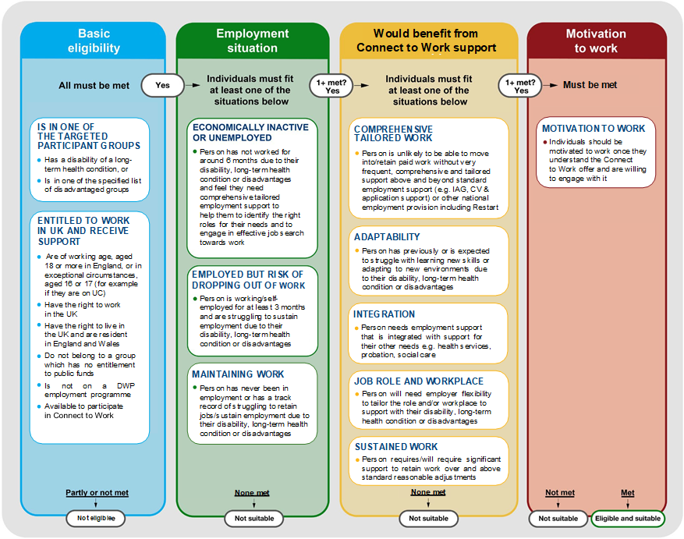
Eligibility and
Suitability
Participants must be eligible and suitable
Notes:
Hani

Slide 16
Cumbria Connect to Work
Notes:
Caroline

Slide 17

Cumbria CtW
Cumberland Council is the contracting body but this is delivered in Partnership with Westmorland and Furness Council
Cumbria CtW is for all eligible and suitable participants regardless of place – all residents should have access to the same quality and breadth of service
We plan to let a single contract across Cumbria
We expect to help around 2,700-3,100 Cumbrian participants (Jan 2026 – March 2030)
Notes:
Caroline

Slide 18
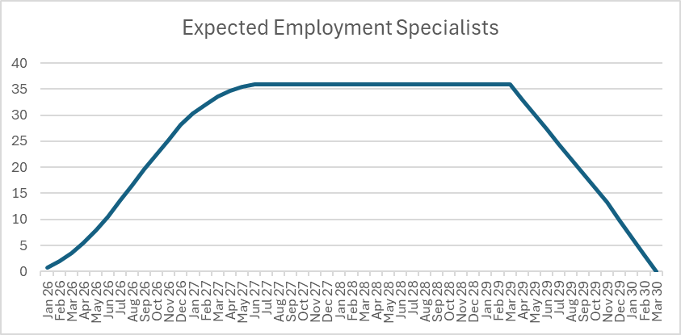
Resourcing
Expected Caseloads
IPS around 25 participants with 75% of participants being IPS
SEQF around 20, with 25% participants being SEQF
Furthermore; we expect:
Consistent Employment Specialist throughout the Participants time on CtW
85% of participants to be Out-of-Work, supported for 12 months
15% of participants being In-Work, supported for 4 months
(based on 3,100 Starts)
Notes:
Caroline

Slide 19
Proposed Delivery Model
Referral Pathways
  Integrated Care Board
  Jobcentre Plus
  Primary care
  Community care and other care settings and social prescribing
  Charities (national and local)
  Local groups
  Prison work coaches and mentors within prisons
  Rehabilitation centres
  Domestic abuse refuges
  Others
Service Coordinator
Employer Engagement
  Employers
  Employer representatives
  Trade bodied
  Sector bodies
  Trade Unions
Local integrated and connected Delivery Partners (sub-contractors)
Investment in their capacity and capability
Some self-delivery where right to do so
Notes:
Caroline

Slide 20
Proposed Delivery Model (2)
Referral Pathways
  Integrated Care Board
  Jobcentre Plus
  Primary care
  Community care and other care settings and social prescribing
  Charities (national and local)
  Local groups
  Prison work coaches and mentors within prisons
  Rehabilitation centres
  Domestic abuse refuges
  Others
Service Coordinator
Employer Engagement
  Employers
  Employer representatives
  Trade bodied
  Sector bodies
  Trade Unions
We also have:
Integrated Care Boards (N, NE, Lancashire and South Cumbria)
Cumbria Health
Health and Growth Accelerator (N Cumbria)
WorkWell
Local integrated and connected Delivery Partners (sub-contractors)
Investment in their capacity and capability
Some self-delivery where right to do so
Notes:
Caroline

Slide 21
Proposed Delivery Model (3)
Referral Pathways
  Integrated Care Board
  Jobcentre Plus
  Primary care
  Community care and other care settings and social prescribing
  Charities (national and local)
  Local groups
  Prison work coaches and mentors within prisons
  Rehabilitation centres
  Domestic abuse refuges
  Others
Service Coordinator
Employer Engagement
  Employers
  Employer representatives
  Trade bodied
  Sector bodies
  Trade Unions
Building and supporting our Employer Engagement strategy, working with key employers on growth and development of our economy and matching employer requirements with good quality and prepared individuals
Local integrated and connected Delivery Partners (sub-contractors)
Investment in their capacity and capability
Some self-delivery where right to do so
Notes:
Caroline

Slide 22
How we will be helping
Our Partnership and Integration Manager will:
  Facilitate referral pathway forum bringing together potential referrers
  Facilitate employer engagement forum bringing together key employers and employer representatives
  Support marketing and communications
  Engaging with functions across the Councils
Council services will have a role within the local delivery through engagement and supporting individuals onto the scheme.
This is consistent with Cumberland Council’s Pre-Front Door Model (Community Hubs) and Front Door (Customer Services). Westmorland and Furness’ Community Power programme is also linked around empowering individuals and to look at the holistic challenges that they are facing.
Notes:
Caroline

Slide 23
Commercial expectations
Notes:
Caroline

Slide 24
Commercial snapshot
Contract Start October 25
Service Commences January 26 (referrals commence)
Contract End March 2030
Out-of-Work Starts cease March 2029
In-Work Starts cease November 2029
Service and Contract End March 2030
75% individual Placement and Support [IPS]
25% Supported Employment Quality Framework [SEQF]
85% Out-of-Work Participants
15% In-Work Participants
1 Contract
Circa £10m excluding VAT over term
2,700 to 3,100 Programme Starts
15% Payment by Results based on Programme Starts
85% Service Fee, paid monthly
Circa 35-40 Employment Specialists required
Notes:
Caroline

Slide 25
Performance Expectations
At least 50% of Out-of-Work Participants achieve first earnings
At least 40% of Out-of-Work Participant Starts to achieve a Lower Threshold Outcome (13 weeks of 9 hours a week NLW)
At least 29% of Out-of-Work Participant Starts to achieve a Higher Threshold Outcome (26 weeks of 18 hours a week NLW)
Achieve 100%+ of Participant Starts on Programme
Out-of-Work Participants
Within programme expectations
75% IPS / 25% SEQF
85% Out-of-Work / 15% In-Work
At least 80% of In-Work Participant Starts to achieve a Higher Threshold Outcome (26 weeks of 18 hours a week NLW)
In-Work Participants
Notes:
Caroline

Slide 26
Shaping the funding model
Implementation
Oct – Dec 25
Service Commencement
Referrals commence January 2026
Support Only
When referrals and starts finish there will be a period of supporting Participant on the programme (“Support Only Phase”) until they complete
Implementation
Mobilisation
Integration
Systems
Ramp up Starts over 6-months
Steady State Starts from month 7 (July 26)
Payment by Results (15%) based on Starts from month 6
Service Fee
Payment by Results [PbR]
Notes:
Caroline

Slide 27
Service expectations
Within the previous context and that of Fidelity we are seeking:
  An organisation that can harness local integrated providers
  Build capacity and capability in the existing ecosystem
  Self-deliver where it is right to do so
  Deliver the overall model with Fidelity
  Ensure that all eligible and suitable Participants get the same level of service (quality and breadth) regardless of place
  Successfully deliver the contract expectations and obligation
  Work in partnership with the Councils to make Cumbria CtW a success
  Help us learn what works and what does not, embracing Continuous Improvement
Notes:
Caroline

Slide 28
Protecting the market
We recognise that Potential Service Coordinators will want to collect information on local providers
We know that this could be a burden for those small organisations
We want to collect information on the local delivery organisations (build a local service directory) so that Potential Service Coordinators can easily find local organisations (we hope that Potential Service Organisations will see this as part of any Expression of Interest process. At the same time try and help reduce the burden on local organisations having to respond to a large number information requests
Templates and publishing details have been issued with this meeting invitation
Notes:
Caroline

Slide 29
Proposed procurement approach
Notes:
Hani

Slide 30
Key initial milestones
August 25
Procurement Commences
January 26
Service Commencement
(referrals)
March 29
Out-of-Work Starts cease
November 29
In-of-Work Starts cease
3,100 Programme Starts
October 25
Contract award and commencement
June 26
Start ramp-up completes and steady state
PbR Commences
March 30
Service and contract ceases
Notes:
Hani

Slide 31
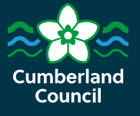


Procurement Process Key Dates
Date | Activity
Mid August 25 | Tender advertised on Chest
Mid Sept 25 | Tender closes
Sept/Oct 25 | Assessment Period and Decision to Award
October 25 | Providers notified of tender outcome
October 25 | Contract mobilisation
January 26 | Service begins
Notes:
Hani

Slide 32

Procurement – what council staff must do
Adhere to the Procurement Act 2023 (PA23) and Cumberland Council’s Contract Procedure Rules.
Deliver value for money services that benefit the public.
Set up simple and easy to follow procurement processes.
Share full information about the procurement.
Be honest, fair, consistent and treat all suppliers the same.
Consider the removal or reduction of barriers for SMEs.
Carry out a ‘Conflicts of Interest’ assessment of those involved in the process.
Notes:
Hani

Slide 33
Electronic Procurement
To submit a bid, you must register (for free) on Find a Tender (the Central Digital Platform) - https://www.gov.uk/find-tender
Need help to register? Guide to registering on Central Digital Platform
When your registration is completed and verified, you can obtain a ‘share code’. Your share code and a copy of your registration details, must be submitted as part of your tender submission.
The Invitation to Tender will be advertised on ‘The Chest’ (the council’s e-procurement portal) and your tender must be submitted via The Chest. You must register (for free) on The Chest (if not registered already) using this link https://www.the-chest.org.uk/
Notes:
Hani

Slide 34
The Procurement Process
Invitation to Tender (ITT) published on The Chest. Includes instructions, service specification, copy of terms and conditions, award criteria, tender documents and deadlines.
Read the ITT and take note of instructions and deadlines.
Read the service specification and ensure you are able to meet the requirements.
Read all other ITT schedules. This includes the ‘Terms and Conditions’, which you must confirm acceptance of when you submit your tender. The T&Cs will not be negotiated after contracts have been awarded.
Ask clarification questions (only on The Chest) by the deadline.
Complete all required tender documents. Ensure you answer only the questions that are asked. Do not exceed word limits.
Notes:
Hani

Slide 35
The Procurement Process (2)
Upload all required tender documents on to The Chest and submit by the deadline (refer to checklist in ITT).
Bids will be evaluated by the council as described in the ITT.
Council’s internal governance is carried out.
Assessment summaries issued on The Chest to successful and unsuccessful suppliers, stating scores and reasons for the scores.
Notes:
Hani

Slide 36
The Procurement Process (3)
Contract Award Notice published; 8 working day standstill commences.
Contracts issued after standstill period to be signed and returned.
Contract Details Notice published, including copy of redacted contract if value is over £5M.
Contract services start or framework is established.
Notes:
Hani

Slide 37
Next Steps
Continue to take part in any other supplier engagement events
Register on the Central Digital Platform
Register on The Chest https://www.the-chest.org.uk/
Look out for the Invitation to Tender (ITT) on The Chest
  Technical issues on The Chest? Contact Proactis:
  Telephone; 0330 005 0352
  Email: suppliersupport@proactisservicedesk.com
Notes:
Hani

Slide 38
Market feedback session
Notes:
Isobel

Slide 39
Questions
We will try and answer as many questions as possible
All questions and answers will be published
If we don’t get to all your questions, hand them to one of the team, or email CumbriaCTW@cumbria.gov.uk
Last day for asking questions will be 24 July with subsequent questions answered via the procurement process
Notes:
Isobel

Slide 40
Next Steps and Closing remarks
Keen to get your feedback through Question-and-Answer process, open to 24 July
We aim to consolidate your feedback into the procurement documents, due for issue w/c 11 August although we can’t guarantee if and when a procurement will happen
We will not be entering into any negotiations or 1-2-1 discussions, any and all communications must be through the commercial and procurement channels
Questions and Feedback: CumbriaCTW@cumbria.gov.uk
All information held on Enterprising Cumbria site: www.enterprisingcumbria.org.uk
If you decide to stay after this event and use the room, you are welcome to, but note that it is not part of our market engagement or procurement activity. We will leave the Question Boxes by the door for a couple of hours
Notes:
Isobel

